Slide 1
INTEGRATING HUMAN CAPITAL STRATEGY WITHIN STRATEGIC PLANNING
Vision
Mission
Critical Success Factors
Priority Actions
Notes:
Today I want to to talk about why and how you integrate human capital strategy within your strategic plans.
I’m going to describe:
Why Integrating an HC Strategy into the Agency Strategic Plan is Essential, and,
Why you base this on three key HC practices that every agency has to get right:
Recruiting the right talent
Keeping the right talent, and
Inspiring and engaging your workforce
Does anyone here refute the notion that people are by far the largest, most critical … and most perplexing resource that agencies have for delivering services?
I didn’t think so. People constitute most of the critical success factors in your plan, and people
Perform almost all of the actions necessary to successfully execute the plan
Leaving HC strategy out of the agency strategic plan is like leaving the motor and wheels out of the design for a new car.
It may be possible one day but it definitely isn’t possible now.

Slide 2
IT’S ALL ABOUT YOU
Vision
Mission
Critical Success Factors
Priority Actions
Notes:
Today I want to to talk about why and how you integrate human capital strategy within your strategic plans.
I’m going to describe:
Why Integrating an HC Strategy into the Agency Strategic Plan is Essential, and,
Why you base this on three key HC practices that every agency has to get right:
Recruiting the right talent
Keeping the right talent, and
Inspiring and engaging your workforce
Does anyone here refute the notion that people are by far the largest, most critical … and most perplexing resource that agencies have for delivering services?
I didn’t think so. People constitute most of the critical success factors in your plan, and people
Perform almost all of the actions necessary to successfully execute the plan
Leaving HC strategy out of the agency strategic plan is like leaving the motor and wheels out of the design for a new car.
It may be possible one day but it definitely isn’t possible now.

Slide 3
Can you guess who this is? An organization where:
They are relatively large and most of the staff and virtually all of the senior executives are centrally located
Telework is strongly discouraged
Managers at the organization have little influence on who’s assigned to their teams
Managers have little influence on their team members’ compensation -- neither their annual salary nor their annual bonus awards
Managers cannot promote team members
Members of the team cannot, without tremendous effort, be fired. (Which is fitting in some ways, because the managers didn’t get to hire the team anyhow.)
The organization hires slowly and has almost never actually fired anyone

Slide 4
A Human Capital Model
Recruit
Retain
Inspire

Slide 5

Notes:
No agency we’ve worked with feels these pressures more acutely than the VA. The VA’s largest component, the Veteran’s Health Administration is the largest health care system in the country. It sees about 9 million veterans a year. We’ve worked with them on many human capital initiatives over the years.
Remarkably, given the constraints it faces, VHA care is, by most measures, equal to, and often better than care provided in the private sector, when judged by standard evidence-based guidelines.
Its strategic workforce planning, in my experience, is by almost every measure superior to anything I’ve experienced in government or the private sector.
It has to be.

Slide 6
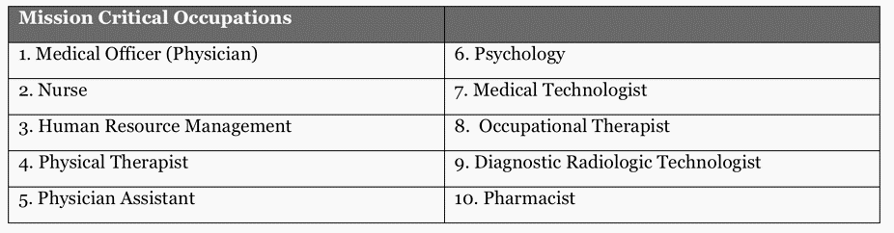
One Result of a Strategy
Notes:
The VHA has more than 200,000 employees. Like Valero, it maps agency strategic objectives (from the strategic plan) to workforce capacities. It’s mission critical occupations read like a who’s who of the world’s most expensive and difficult to fill occupations. Yet the VHA does so despite offering significantly lower pay than what most individuals in these positions can earn in private practice. And it does so despite withering and relentless, near constant criticism.
The VA is under intense scrutiny. The occasional scandal captures all the attention. This causes people to forget just how good the veteran health system is, at least in relative terms.
Despite challenges that would make any private sector CEO turn pale, the VHA operates at a high level, again, as good or better than our other healthcare systems.
I am convinced its because they take strategic planning and human capital strategic planning seriously. It’s not shelfware. Their 2016 strategic workforce plan runs more than 125 pages. More importantly, it methodically maps each and every strategic VA priority to the workforce. It identifies gaps in terms of internal and external trends and it lays out exactly what the agency plans to do to close the gaps. It describes, in detail, precisely which occupations will receive exactly how much of the department’s recruitment and retention resources and why. It lists the actions the agency will take to attract, recruit, retain and inspire its workforce.
Except for this foresight and world class commitment to integrated strategic and workforce planning the system might have collapsed years ago.
The VHA does an outstanding job of linking Department Strategy to Workforce Planning, particularly where recruiting and retaining talent are concerned. They also address engagement and inspiration.
But I want to turn to another story to illustrate that.
(Next slide>

Slide 7
A Human Capital Model
Recruit
Retain
Inspire

Slide 8
How to Strategize about a Workforce
Assess
Think
Take Action
Measure Outcomes

Slide 9
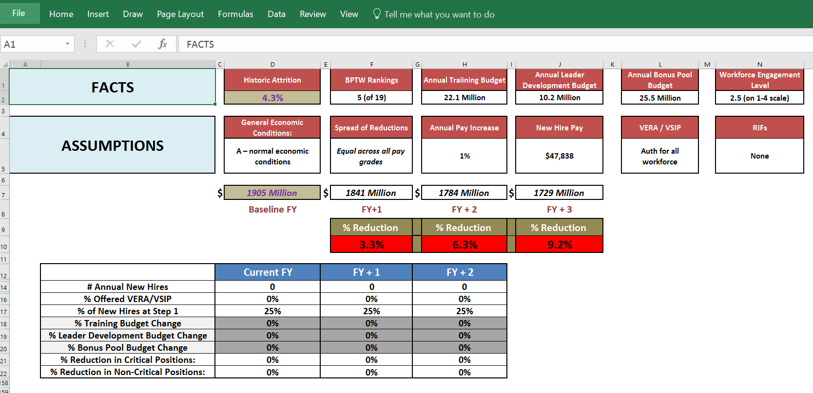

Slide 10
Questions to start with
Which segments of the workforce and which jobs create the most value?
In what areas is the talent market heating up? How will my agency/department be impacted?
Which areas of my agency/department will be most severely impacted by retirements?
Are we successfully transferring and preserving knowledge?
What are we doing to prepare successors?
What skills /competencies will we need over the next 5 years that we don’t currently have? How do we get these skills?
What is our attrition within critical areas? What is this costing us in terms of clients, productivity, quality and innovation?
What are the key challenges faced by the main “business” divisions in the agency/department? How can we use our deep knowledge of Human Capital Management and our workforce to aid business division leaders in overcoming their challenges?
Where precisely can we reduce in order to meet budget restrictions and free resources for critical growth areas?

Slide 12
Backup Slides

